Slide 1
Status update

Slide 2
Things I have done
Written sections for all main segments (NLP, NN, Parser, kinematics)
Created a “finished” version of the full pipeline (done but only with one action)

Slide 3
Written sections for all main segments condense more combine chapt. 1 & 2 too long. Make it clear whar I have done in comparison with what others have done
Natural language processing:
Write feedback from section here
Neural networks
Combine with NLP
Move background to background
More clarity about how I would use it

Slide 4
Written sections for all main segments
Parser pipeline
Write feedback from section here
Kinematics for UR
Write feedback from section here
Integration
Write feedback from section here

Slide 5
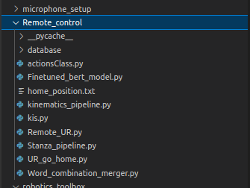
Full pipeline (not completely true yet)
Physical UR5e robot
Sequence of kinematical actions
RTDE communication
potentially voice to text
System interface
System feedback:
Errors
Warnings
Successes
Natural language from user in text form
Sequence of simple actions
Analysed deconstructed sentence
UR kinematics calculator
Actions converter
Parser Pipeline
NLP pipeline (STANZA)
NLP processed text

Slide 6
Full pipeline (not completely true yet)
Physical UR5e robot
Sequence of kinematics actions
RTDE communication
potentially voice to text
System interface
System feedback:
Errors
Warnings
Successes
Natural language from user in text form
Sequence of simple actions
Analysed deconstructed sentence
UR kinematics calculator
Actions converter
Parser Pipeline
NLP pipeline (STANZA)
NLP processed text

Slide 7
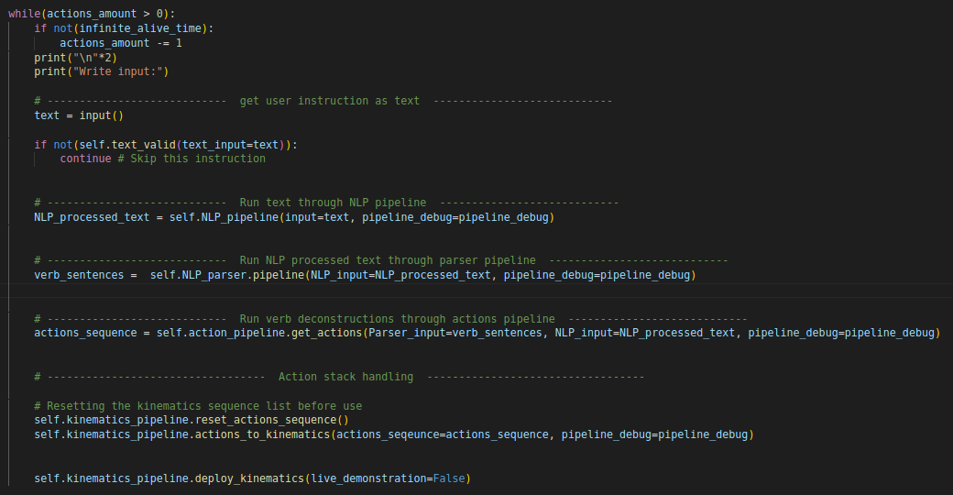
Pipeline in code
Code in interfacer.py

Slide 8
Subject and destination objects
Subjects for movement:
Robot itself
Frames (is supported, not implemented)
All robot joints (has its own set of destination objects)
Movement destinations:
Predefined frames
Online created frame positions

Slide 9
Implemented actions
Action: MOVE
Action: Pick up / put down
Action: ROTATE (potentially the same as MOVE)
Action: PATTERN (don’t know how)
Action: Repeat (blend&move without stopping) rbt github.io -> trajectories note there is a bug: if you start and end point is the same in one of the axises: fix, is make slightly small change
Action: Do if (experimental, maybe not in finished thesis)

Slide 10
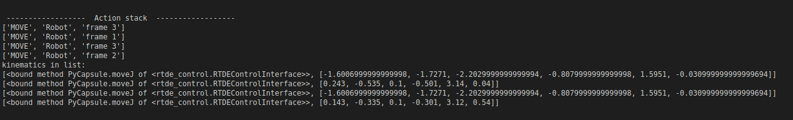
Cool outputs – Deconstructed text to simple actions
Input: ” move to frame 3 then move to frame 1 then move to frame 3 then move to frame 2”
Simple actions list
Kinematics sequence: try: “ move AFTER and BEFORE” using points

